Slide 1
Report on Indian- Elections- Analysis
Examination of Indian Election Data: State and National Election Records from 1977 – 2015

Slide 2
Analysis of Indian Election Dataset: State and National Level Election Data from 1977 – 2015
1. Introduction The Indian Election Dataset offers a detailed look at state and national-level election data spanning nearly four decades, from 1977 to 2015. This report aims to delve into the dataset's intricacies, uncovering significant trends, patterns, and insights.

Slide 3
Analysis of Indian Election Dataset: State and National Level Election Data from 1977 – 2015
2. Dataset Overview The dataset encompasses a wide range of election-related information, including:
1. Election year specifics
2. State and constituency details
3. Candidate particulars (name, party affiliation, votes obtained)
4. Election categorization (general, by-election, etc.)
5. Voter turnout figures
6. Election outcomes (successful candidate, victory margins, etc.)
The programming calculations are done by using Google Colab
https://colab.research.google.com/drive/129CE-2HOPDKJISTHiTcrvuASvJ-sPHN_

Slide 4


Sum of totvotpoll by st_name
Power BI Desktop
Sum of totvotpoll and Sum of electors by pc_name
Sum of totvotpoll Sum of electors
Sum of electors, Sum of totvotpoll and Sum of year by partyabbre
Sum of elec… Sum of t… Sum of y…
50bn
_{D} average elector
 
Sum of totvotpoll
0.5bn

Sum of totvotpoll a…
0.5bn
Sum of electors,…
1.12M
Average of electors
0.0bn
Uttar Pra…
West Ben… Andhra P…
Bihar Maharas… Tamil Na… Madhya … Karnataka Rajasthan
0.0bn
Aura…
Maha… Hami… Dum … Barasat Jadav… Aram… Tamluk Cooc… Murs… Hoog…
0bn
IND
INC BJP BSP SP JD
NOTA CPM
st_name
pc_name
partyabbre
Sum of totvotpoll by partyname and pc_type
pc_type GEN SC ST 1.0bn
Sum of totvotpoll by cand_name and st_name
st_name Andaman & Ni… Andhra Pra…
Sum of totvotpoll and Sum of pc_no by pc_type
Sum of totvotpoll Sum of pc_no
3bn
Sum of totvotpoll and Sum of year by st_name
Sum of totvotpoll Sum of year
Sum of totvotpoll
Sum of totvotpoll and Su…
Sum of totvotpol…
0.5bn
Sum of totvotpoll
5M
0.5bn
2bn
0.0bn
0M
1bn
0.0bn
Indian…
Bharat…
BJP INC
Com… Janata… Indep… Indian… Bahuj…
None O…
Anil Basu Mullap… Ram Vil… Mamat… Rupcha… Sharad … Hannan… Indrajit … Pawar S… Mulaya…
Uttar Pr…
West B… Andhra…
Bihar Mahara… Tamil N… Madhy… Karnata…
0bn
GEN
SC
pc_type
ST
partyname
cand_name
st_name

Slide 5

Sum of totvotpoll by partyabbre and ac_type
ac_type BL GEN SANGH SC ST
Sum of totvotpoll by partyname
Sum of totvotpoll by st_name and partyname
partyn… A S P Aa S P AAAP
100%
Sum of totvotpoll by partyname and st_name
st_name Andhra Pr… Arunachal …
Power BI Desktop
Sum of totvotpoll
0.5bn
Sum of totvotpoll
Sum of totvotpoll
Sum of totvotpoll
0.5bn
0.5bn
50%
0.0bn
0.0bn
Indian N…
Bharatiya…
INC BJP
Independ… Commun… Independ… Bhartiya J… Bahujan …
INC
BJP IND CPM BSP TDP JD
JNP SP
0%
Uttar Pr…
Mahara… Andhra … West Be…
Bihar Tamil N… Madhya… Karnata… Rajasthan
0.0bn
Indian …
Bharatiy…
INC BJP
Indepen… Commu… Indepen… Bhartiya… Bahujan…
partyabbre
partyname
st_name partyname
Sum of totvotpoll and Sum of year by partyname and st_name
st_name Assam Bihar Chhattisg… Goa Gujarat Haryana
35M
30M
Sum of totvotpoll and Sum of year by partyname
Sum of totvotpoll Sum of year
_{D} average ac no for each year
 
25M
Showing results for
Average ac no sorted by year
Sum of year
Sum of totvotpoll …

20M
0.5bn
200
15M
Average of ac_no
100
10M
0.0bn
Indian …
Bharatiy…
INC BJP
Indepen… Commu… Indepen… Bhartiya… Bahujan…
5M
0
1960
1980
2000
2020
0M
partyname
year
0M
20M
40M
Sum of totvotpoll
60M
80M

Slide 6
Inferences from Indian Elections Dataset
The maximum voter turnout is for Uttar Pradesh. West Bengal follows next
The average number of electors is 1.12 M
The total voter poll and electors is plotted against parliamentary constituency name
Several Analysis is done similarly

Slide 7
Analysis of Indian Election Dataset: State and National Level Election Data from 1977 – 2015
3. Data Analysis
3.1 Election Trends Over Time
→ Election Frequency: The dataset reveals a consistent increase in the number of elections held over the years, indicating the evolving nature of India's democratic process. A pie chart is used to simply calculate number of times each year occur, this is frequency and plot it over years.
→Voter Turnout: Analyzing voter turnout trends reveals fluctuations influenced by factors such as political climate, social movements, and voter awareness campaigns. Voter turnout is the percentage of voters registered who casted their votes.

Slide 8
Election Trends Over Time
Power BI Desktop
Count of year by year
Quick measure
year
1979
1992
1997
2015
1984
1982
2010
1983
1987
2001
1978
1999
2000
1994
2003
2006
1998
2011
2004
2005
2002
2007
2013
24.62K (7.52%)
0.39K (0.12%)
5.13K (1.57%)
5.73K (1.75%)
5.77K (1.76%)
5.9K (1.8%)
5.95K (1.82%)
6.17K (1.88%)
6.48K (1.98%)
6.68K (2.04%)
21.12K (6.45%)
17.74K (5.42%)
17.27K (5.28%)
7.35K (2.25%)
7.7K (2.35%)
17.06K (5.21%)
8.17K (2.49%)
10.04K (3.07%)
16.94K (5.18%)
10.98K (3.35%)
16.72K (5.11%)
11.32K (3.46%)
15.63K (4.77%)
14.12K (4.31%)
11.54K (3.53%)
11.97K (3.66%)

Slide 9
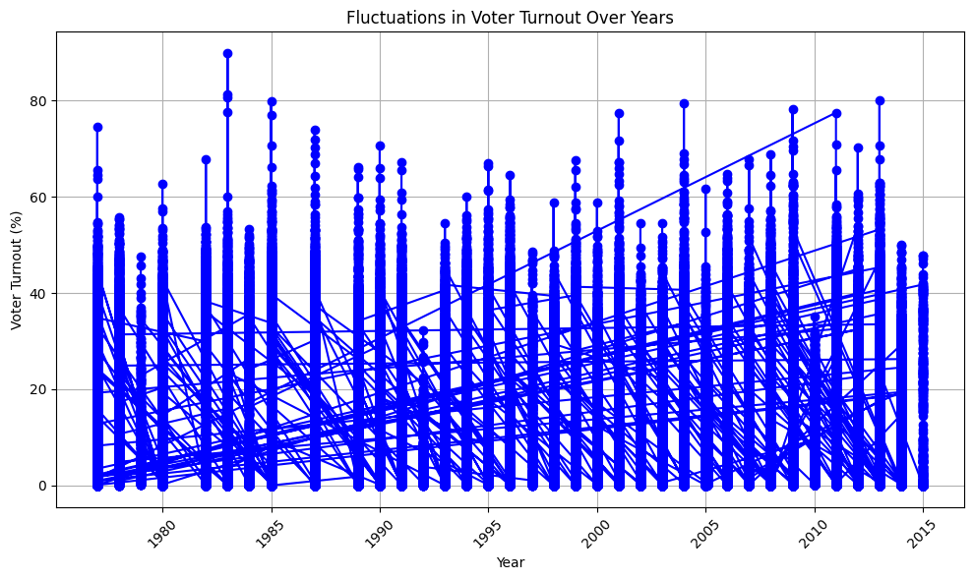
Election Trends Over Time

Slide 10
Analysis of Indian Election Dataset: State and National Level Election Data from 1977 – 2015
3.2 Party Performance
→Key Party Players: Identification of dominant parties in different states and regions based on their electoral performance over the years.
→Party Collaborations: Examination of party alliances and their impact on election results, shedding light on the dynamics of coalition politics

Slide 11
Count of electors and Count of totvotpoll by st_name
Count of electors Count of totvotpoll
140K
Power BI Desktop
120K
Count of electors and Count of totvotpoll
100K
80K
60K
40K
20K
0K
Bihar
Haryana
Gujarat
Odisha
Assam
Kerala
Punjab
Mizoram
Sikkim
Manipur
Tripura
Goa
Tamil Nadu
Karnataka
Rajasthan
Jharkhand
Meghalaya
Nagaland
Uttar Pradesh
Maharashtra
Andhra Pradesh
West Bengal
Chhattisgarh
Uttarakhand
Puducherry
Madhya Pradesh
Jammu & Kashmir
Himachal Pradesh
Arunachal Pradesh
National Capital Territory Of Delhi
st_name

Slide 13
Analysis of Indian Election Dataset: State and National Level Election Data from 1977 – 2015
3.3 Candidate Analysis
→Margin of Victory: Reviewing victory margins helps gauge election competitiveness and candidate strength.
→Candidate Profiles: Profiling successful candidates based on demographics like age, gender, education, and political experience.

Slide 14
Analysis of Indian Election Dataset: State and National Level Election Data from 1977 – 2015
3.4 Regional Analysis
→State-specific Dynamics: Comparing election dynamics across states highlights variations in voter preferences, political ideologies, and regional concerns.
→Urban vs. Rural: Contrasting voting patterns between urban and rural areas uncovers insights into voter behavior and candidate appeal in different settings.

Slide 15
Analysis of Indian Election Dataset: State and National Level Election Data from 1977 – 2015
4. Insights and Findings
→Rise of Regional Influence: The dataset potentially reflects the growing influence of regional parties, challenging the dominance of national-level parties in specific regions.
→Voter Engagement Challenges: Analysis may reveal hurdles to voter participation, suggesting areas for targeted outreach efforts and electoral reforms.
→Demographic Shifts: Exploring changes in voter demographics, such as the impact of youth voter initiatives, provides insights into electoral dynamics.

Slide 16
5. Conclusion Analyzing the Indian Election Dataset yields valuable insights into India's electoral landscape, offering a foundation for strategic decision-making, further research, and policy development. Understanding historical election trends aids in shaping future electoral strategies and governance frameworks.

Slide 17
6. Recommendations
→Dive deeper into specific election cycles or regions for nuanced insights.
→Investigate correlations between economic indicators, social factors, and electoral outcomes for a comprehensive understanding.
→Consider implications for political forecasting, voter education, and electoral integrity measures based on dataset findings.

Slide 18
References The citations for data analysis methodologies and any referenced literature or sources used in the report are as follows::
Acknowledgements
Bhavnani, Rikhil R., 2017, "India National and State Election Dataset", http://dx.doi.org/10.7910/DVN/26526 Harvard Dataverse Network V2.

Slide 19
Conclusion
Results are displayed in PowerBI Dashboards.

